Slide 1


AI RESUME SHORTLISTING SYSTEM
1. GOURAV KUMAR
UNIVERSITY ROLL-NO : 10300224219
2. MD. ALFAJ HUSSAIN
UNIVERSITY ROLL-NO : 10300224224
3. KOUSHIK BARMAN
UNIVERSITY ROLL-NO : 10300224221
Project Link: https://ai-resume-shortlisting-system-2-0.onrender.com/

Slide 2

INTRODUCTION
Resume shortlisting is a crucial part of recruitment. With thousands of applications per job role, manual screening becomes inefficient, error-prone, and time-consuming. This project uses Artificial Intelligence and Natural Language Processing to automate resume shortlisting and ranking based on job requirements.

Slide 3


WHAT IS RESUME SHORTLISTING ?
Resume shortlisting is the process of filtering job applications to identify the most suitable candidates for a specific role based on skills, experience, and qualifications.
Challenges:
  Time-consuming manual process
  Human bias and inconsistency
  High chance of missing qualified candidates

Slide 4
PROBLEM STATEMENT
Manual resume screening is difficult because:
02
04
Human fatigue leads to errors
Delays in hiring process
01
03
Recruiters must analyze hundreds or thousands of resumes
Inconsistent evaluation criteria
There is a need for an automated, fast, and unbiased resume screening system.

Slide 5




WHY AI IS USED?
  AI can process thousands of resumes in seconds
  Eliminates human bias
Improves accuracy and consistency
  Scalable for large organizations
Learns patterns from historical hiring data

Slide 6
OBJECTIVES OF THE PROJECT
  Build an automated resume shortlisting system
  Categorize resumes based on job roles
  Reduce HR manual effort
  Provide fast and accurate shortlisting results
  Deploy a real-time web application

Slide 7
SCOPE OF THE PROJECT
  Resume upload in digital format
  Text extraction and preprocessing
  Resume classification using ML
  Shortlisting based on relevance score
  Web-based interface for HR users

Slide 8
TECHNOLOGIES USED
  Programming Language: Python
  Machine Learning
  Web Framework: Flask
  Frontend: HTML, CSS
  Deployment: Render

Slide 9
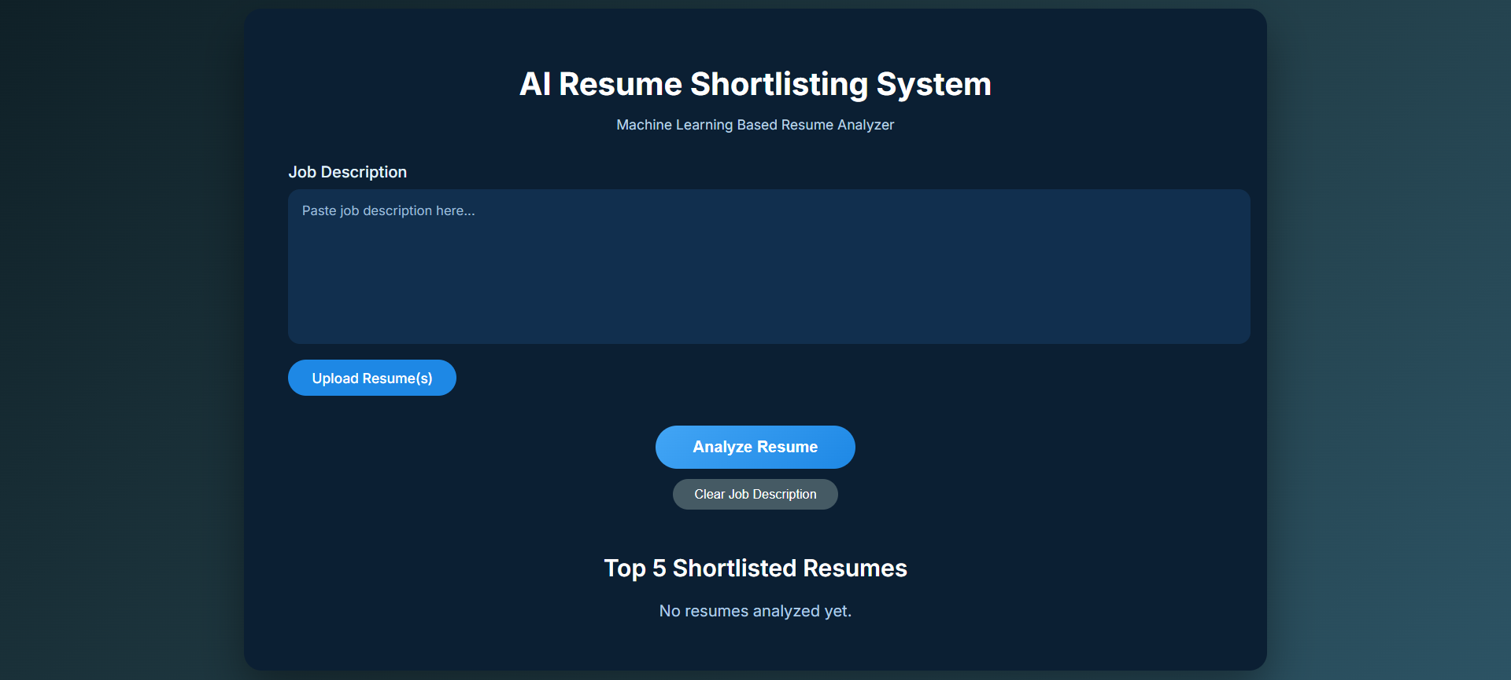
RESULTS

Slide 10
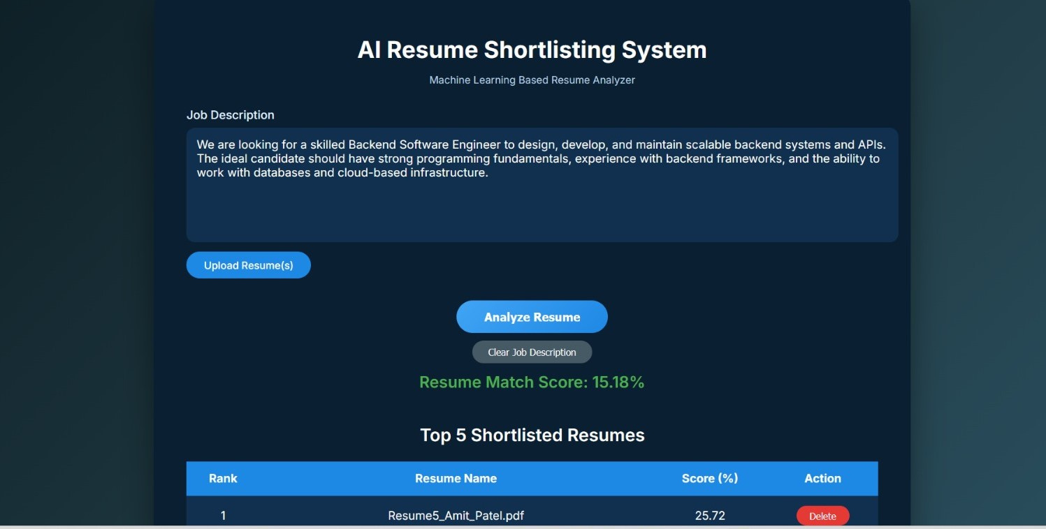
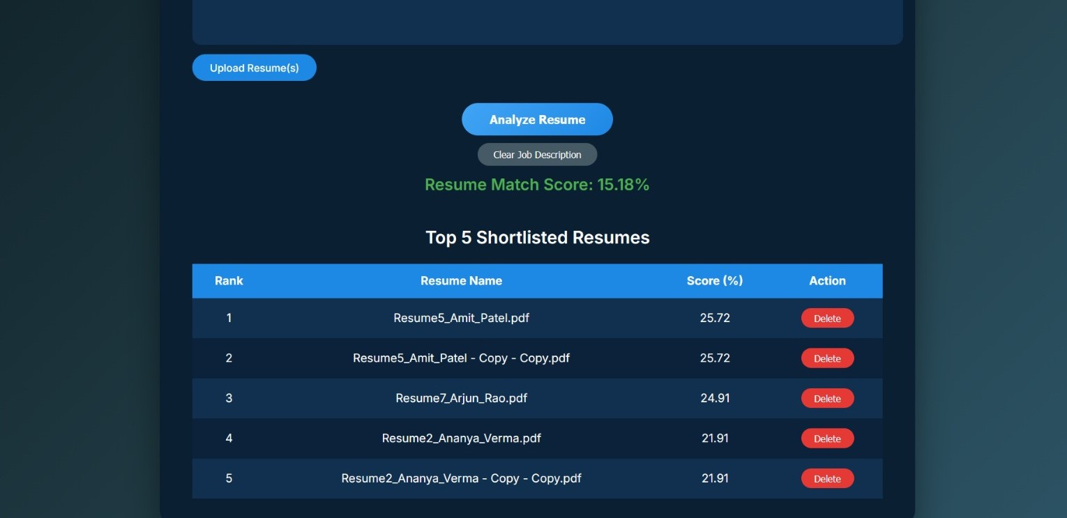
RESULTS

Slide 11
FEATURES OF THE SYSTEM
  Resume text screening
  Automated resume classification
  Fast prediction results
  User-friendly web interface
  Real-time output

Slide 12
ADVANTAGES OF THE SYSTEM
  Saves time for HR teams
  Improves hiring efficiency
  Reduces recruitment cost
  Eliminates bias
  Scalable and reliable

Slide 13
LIMITATIONS
  Depends on quality of training data
  Limited to predefined job categories
  Accuracy may vary with resume format

Slide 14
CONCLUSION
The AI Resume Shortlisting System successfully automates the resume screening process, making recruitment faster, smarter, and unbiased. It demonstrates the effective use of Machine Learning and NLP in real-world HR applications.

Slide 15
THANK YOU

